Slide 1



Data Wrangling & Munging: Organising, Managing and Enabling Data for Analysis©
Prof. John MacInnes & Dr Diarmuid McDonnell
University of Edinburgh
July 2018
© Diarmuid McDonnell

Slide 2



Slide 3
Why
Rationale for the workshop:
“Many organizations can barely find a way to use their R/Python programmers on reasonable datasets.”
“The piece missing from the data science movement right now is really simple: intelligent application of data science tools.”
https://www.linkedin.com/pulse/data-science-dead-5-years-less-justin-b-dickerson-phd-mba-pstat- accessed 16.07.2018.

Slide 4
Part I
The Workflow

Slide 5
A Thought Experiment
Be honest….
Have you ever lost a file?
Have you ever wondered if you have deleted a file?
Have you and a colleague ever been working on different versions of a file?

Slide 6
A Thought Experiment
Be honest….
Have you ever struggled to identify which data file is the correct one?
custinfo_2014.xlsx
custinfo_recent_2014.xlsx
cinfo_report2014.xlsx

Slide 7
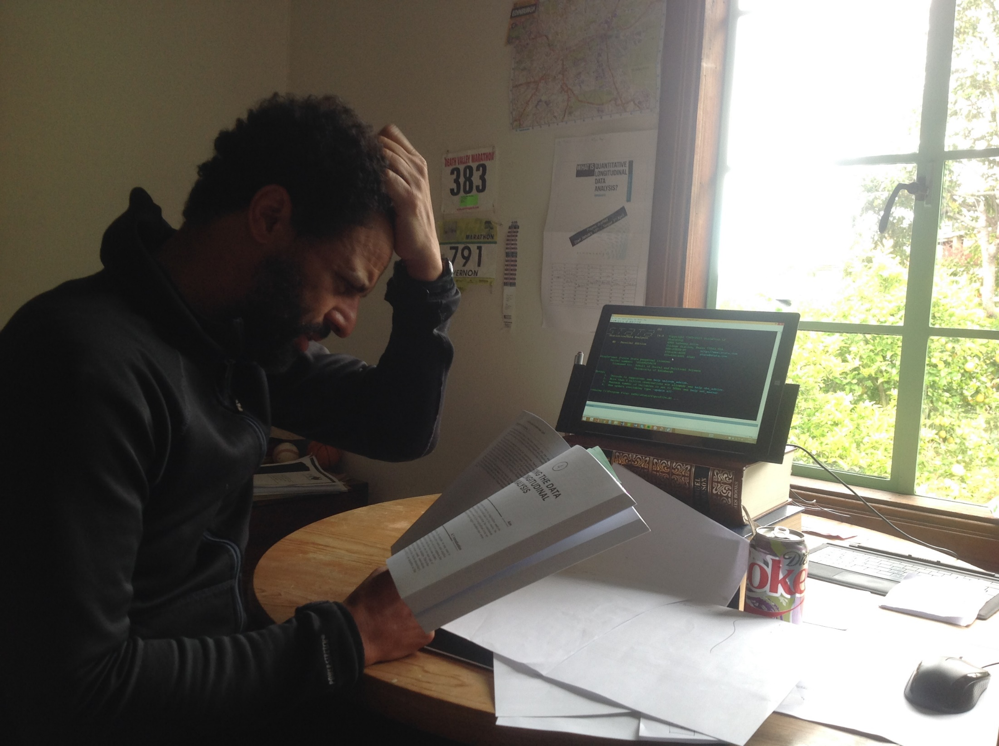

Slide 8
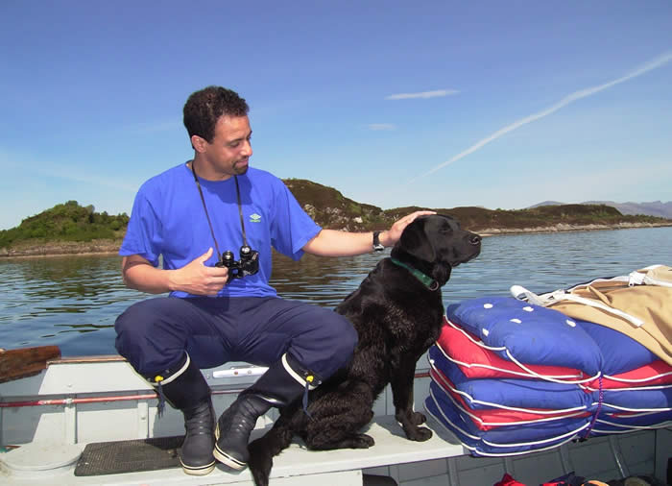

Slide 9
The Workflow
Planning, organising and documenting work
This includes…
Cleaning data
Analysing data
Presenting results
Backing up and archiving material

Slide 10
The Workflow
Workflow should be planned and carefully orchestrated
Workflow MUST not be adhoc
(e.g. piece-meal, developed as a reaction to mistakes etc.)

Slide 11
The Workflow
Better supporting YOU and what YOU DO
Not changing you into something YOU ARE NOT
Notes:
There is not one workflow. However, any workflow must be systematic, transparent, replicable and productive.

Slide 12

Shopping without a list? Cooking with a list?

Slide 13
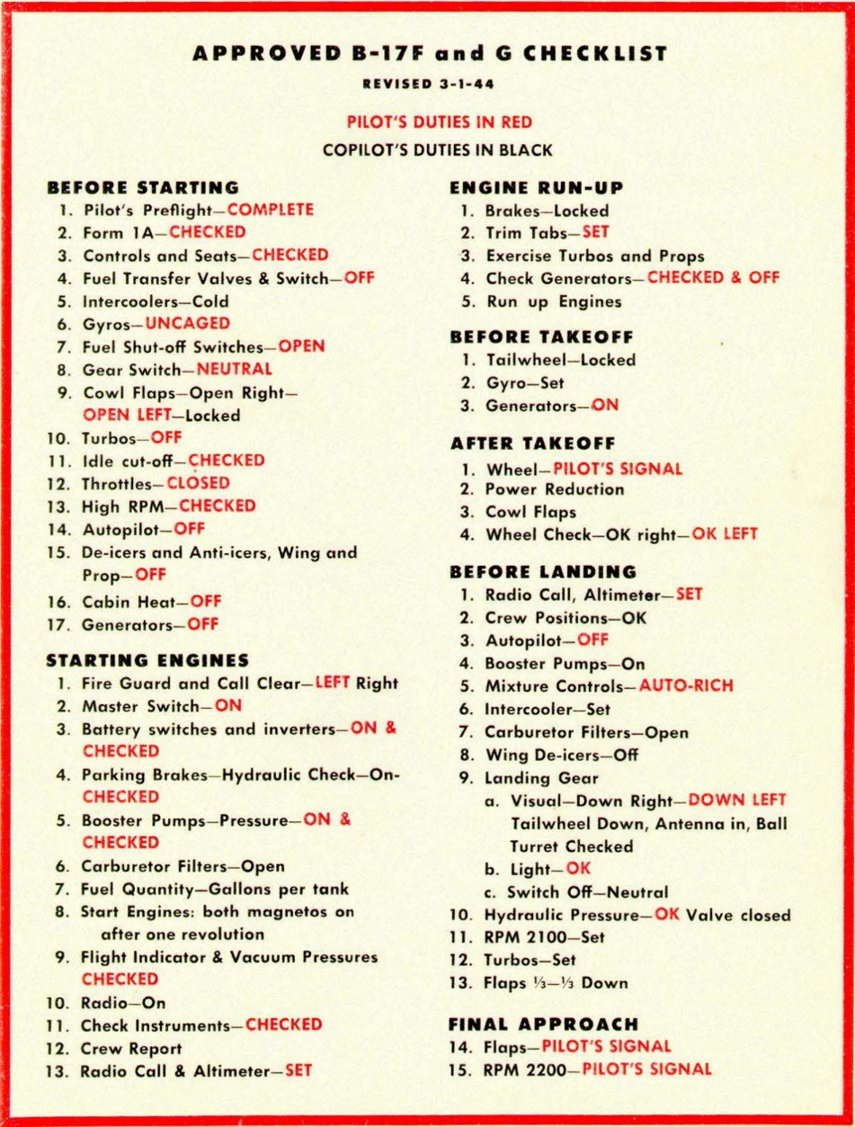
In the late 1930s, military aviators in the American Army and Navy began using aviation checklists. Checklist became part of a new paradigm for how to fly, which consisted of
• Elaborate standardized procedures for many activities
• Checklists to ensure all critical steps had been done
• Quantitative tables and formulas that specified the best settings, under different conditions, for speed, engine RPM, gasoline/air mixture, engine cooling, and many other parameters.
This new paradigm (Standard Procedure Flying) had a major influence on reducing aviation accidents and increasing military effectiveness during World War II, particularly because of the rapidly increasing complexity of military aircraft, and the huge number of new pilots.
Despite the benefits of Standard Procedure Flying for both safety and efficiency, by the end of WWII only a few air forces had fully embraced it
Roger Bohn http://www.vs29.org/Links/NATOPS/SOP-bohn-2013-1.pdf

Slide 14
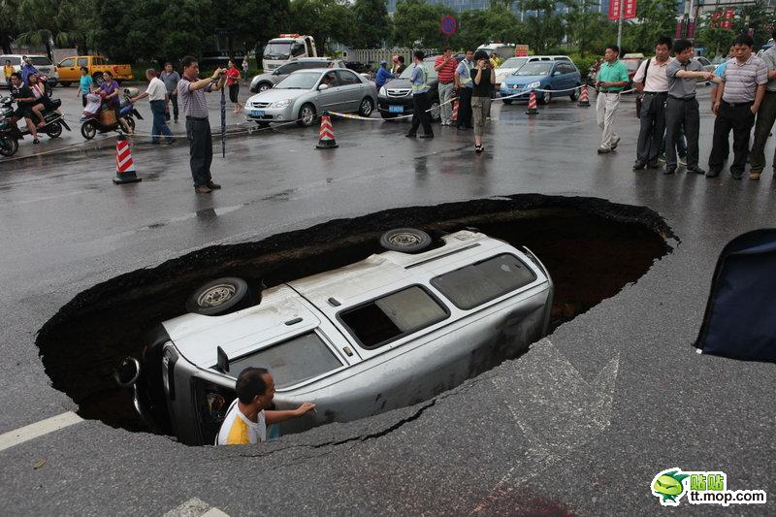
The Workflow
The Platinum Standard

Slide 15

The Four Pillars
of Wisdom

Slide 16

A Planned Workflow Has Benefits
Efficiency
Transparency
Accuracy
Reproducibility

Slide 17
Four Pillars of Wisdom
Accuracy
minimising information loss and errors in analyses and output
Efficiency
automation, maximising features in software
Transparency
showing what you did, why, when, how
Reproducibility
same results every time whoever or wherever
editing, rewriting reports or re-submission of papers

Slide 18
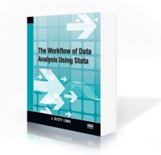
J. Scott Long has posted a really good pdf version of a talk on the workflow http://www.ihrp.uic.edu/files/Workflow%20Slides%20JSLong%20110410.pdf

Slide 19
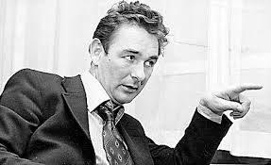
The best habit that you can get into
is to get into good habits!

Slide 20
The Workflow
Drukker’s dictum: Never type anything that you can obtain from a saved result
Gayle’s dictum:
You can’t be too fit or have too many publications
However…

Slide 21


500+ scientific publications in peer reviewed journals (15,000+ citations and an H-index of 66)
Has run more than 70 marathon and ultra-marathon races, including seven 90km Comrades Marathons and fifteen 56km Two Oceans Marathons
http://www.essm.uct.ac.za/ESSM/Tim_Noakes

Slide 22
Long’s Law
It is always easier to document today than it is tomorrow!
Corollary 1:
Nobody likes to write documentation
Corollary 2:
Nobody every regrets having written documentation

Slide 23

Long’s Law
Has anyone in the history of data analysis ever said
“these files are too well documented”

Slide 24
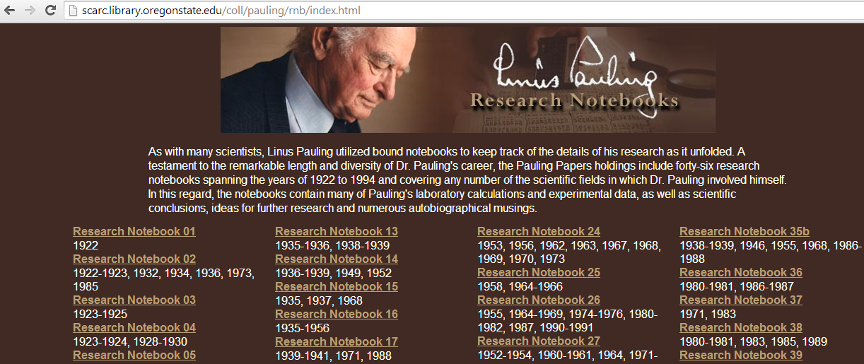

Slide 25
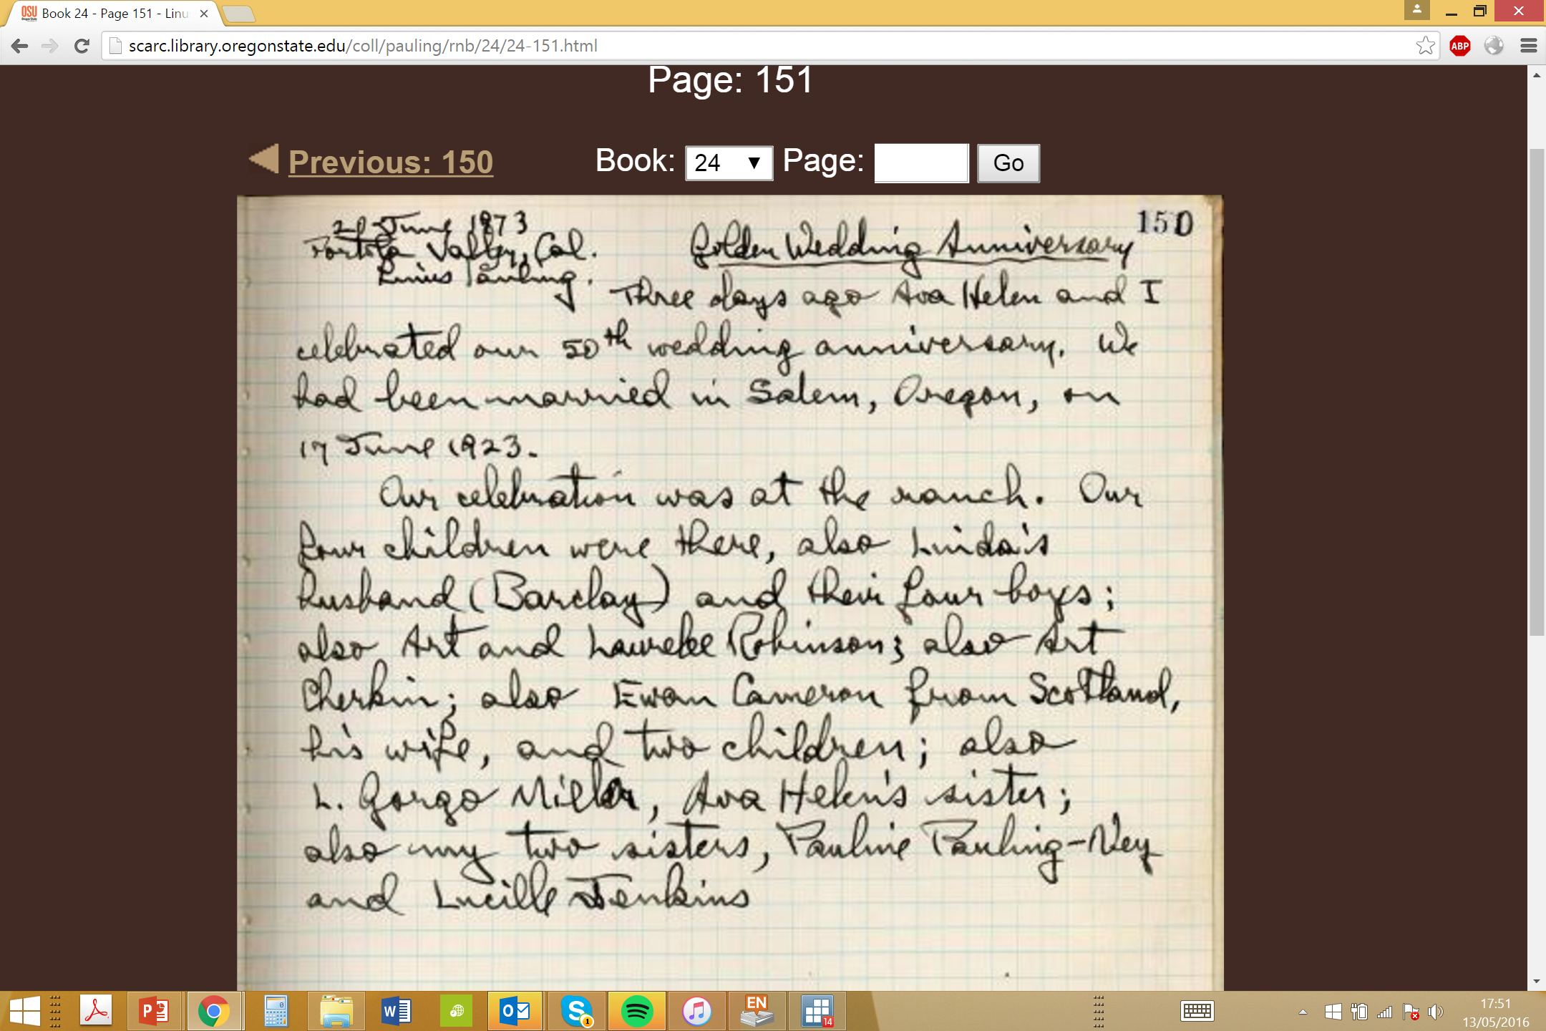

Slide 26
The Workflow
Improving the workflow with a modest amount of effort
The less experience you have the better
start from the very beginning

Slide 27
The Workflow
ALL SERIOUS WORK MUST BE REPRODUCIBLE!
There MUST be an audit trail

Slide 28
The Workflow
Why is it all so difficult?
Social science data tends to come in messy formats
Administrative data often is even more complex in nature than social survey data

Slide 29
The Workflow
Why is it all so difficult?
Minor decisions have major consequences…
Which cases?
Which variables?
How to code (e.g. education)?
How to recode?
Where do I truncate?
Can I trace these decisions in my audit trail?

Slide 30
The Workflow
Why is it all so difficult?
Poor discipline and insufficient documentation

Slide 31
The Workflow
File Naming Protocols
File Name =
name_date_depositor's initials_version_type

Slide 32
The Workflow
File Naming Protocols
File Name = name_date_depositor's initials_version_type
Therefore bhpsaindresp_20140506_vg_v1.dta
Would be a
a.. The British Household Panel Survey File “aindresp”
b.. Deposited on 6th May 2014
c.. Deposited by vg (Vernon Gayle)
d.. Version v1
e.. File type (e.g. a Stata .dta file)

Slide 33
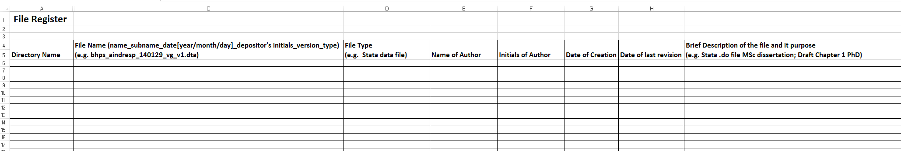
Other seemingly small issues such as ‘Directory Structures’ and ‘Variable Naming Conventions’ are similarly worth thinking about!

Slide 34
Hidden Realities
Collaboration
Team working
Version Control

Slide 35






Slide 36
Part II
Stata

Slide 37



Slide 38
Spreadsheet can not easily be scripted –
So there will be no clear audit trail of activity

Slide 39
If you use a ‘gui’ then one day you will inevitably end up in a sticky mess
We advise against undertaking data analyses using software packages in interactive modes, for example through a graphical user interface (gui) such as drop-down menus.

Slide 40
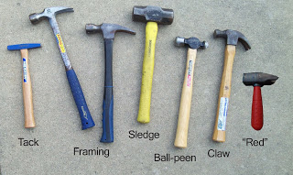
Which tool?

Slide 41
Which software (or data analysis package) should I learn?
“This is like asking which five countries should I know about, given that I don’t have an interest in either geology or politics – the answers is it depends”
Larry Wall (the creator of the programming language Pearl)

Slide 42
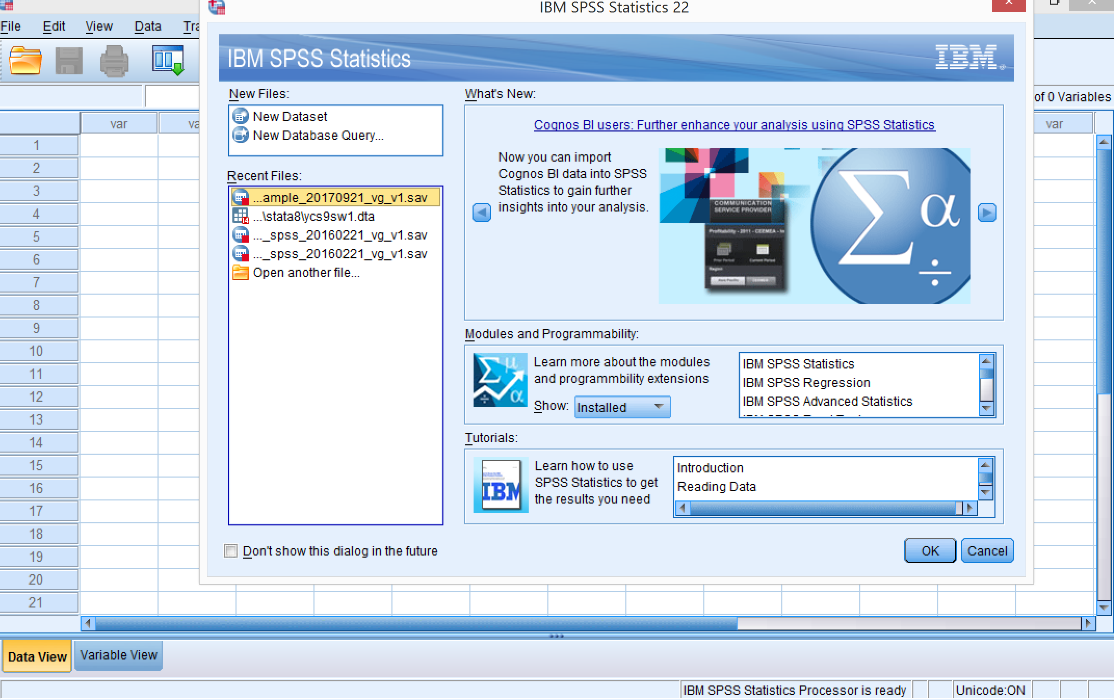
SPSS

Slide 43
SPSS
Statistical Package for the Social Sciences
Was widely taught in university departments (e.g. psychology, sociology, health etc.)
Commercially available
www.ibm.com/DataStatistics/SPSS

Slide 44
SAS
Now only widely used in government departments
Re-launched as a data science package
Commercially available
Fiddly to get started with
www.sas.com

Slide 45
R
Growing in popularity (e.g. data science, statistics, science etc.)
Popular with statisticians
Free (open source)
Difficult to learn
Development and support is not commercial
Help resources are under-developed
https://cran.r-project.org

Slide 46
Other Approaches
Python (www.python.org)
Open source
Fewer libraries than R
Tricky to learn and almost no help resources
Julia (https://julialang.org/)
Open source
Fewer libraries than R
Tricky to learn and no help resources

Slide 47
Stata
Popular in economics globally
Popular with US social science (e.g. sociology)
Commercial software
Easy to learn
Excellent development
Outstanding help files and teaching resources
www.stata.com

Slide 48
Stata
Does all the routine stuff (SPSS, SAS & R)
Fits many more models than standard software (esp. for selection, longitudinal)
Specialist complex survey analysis functions (Svy) (useful for UKHLS, MCS etc)
Human readable format
Very strong documentation
Worldwide user community (lists etc)
New features almost daily

Slide 49
‘…[Stata] has gotten better and better over time, so that by now it can happily be used as a general-purpose package. Stata is powerful and fast which makes it viable to carry out analysis on a PC…
Overall, Stata is a very good choice for our kind of work’
(Treiman 2009 p.66)

Slide 50

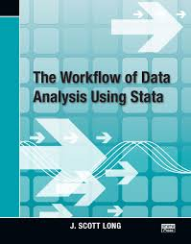
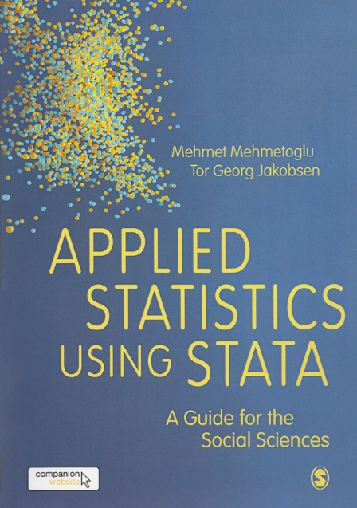
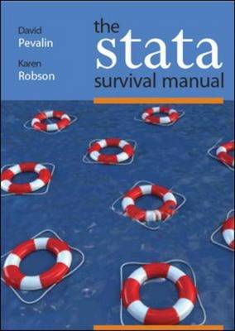

Slide 51
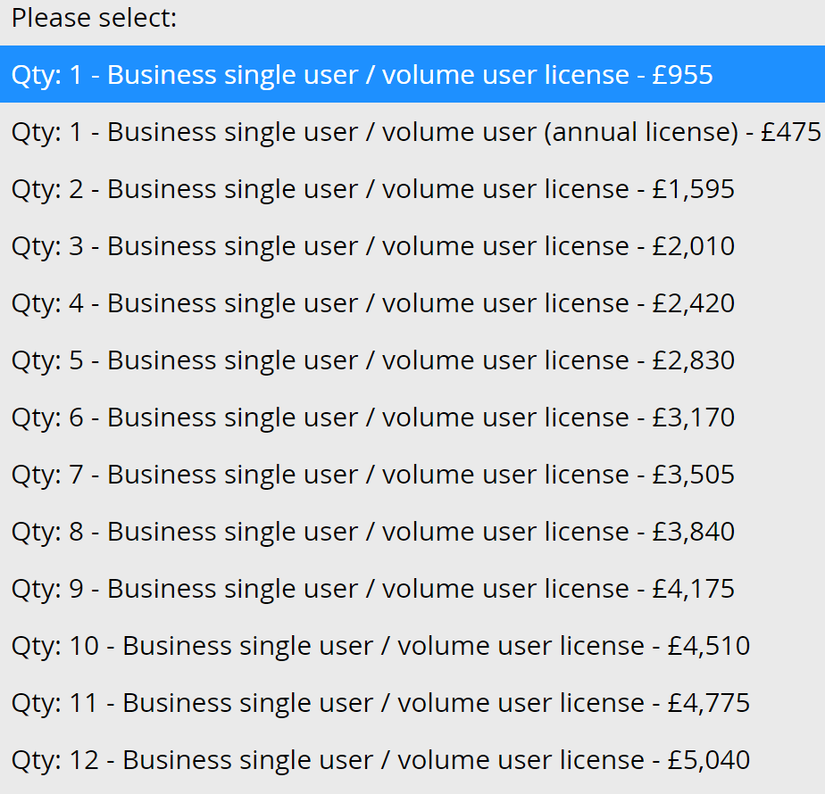
http://www.timberlake.co.uk/software/stata/business/single/prices.html

Slide 52
Using Stata

Slide 53
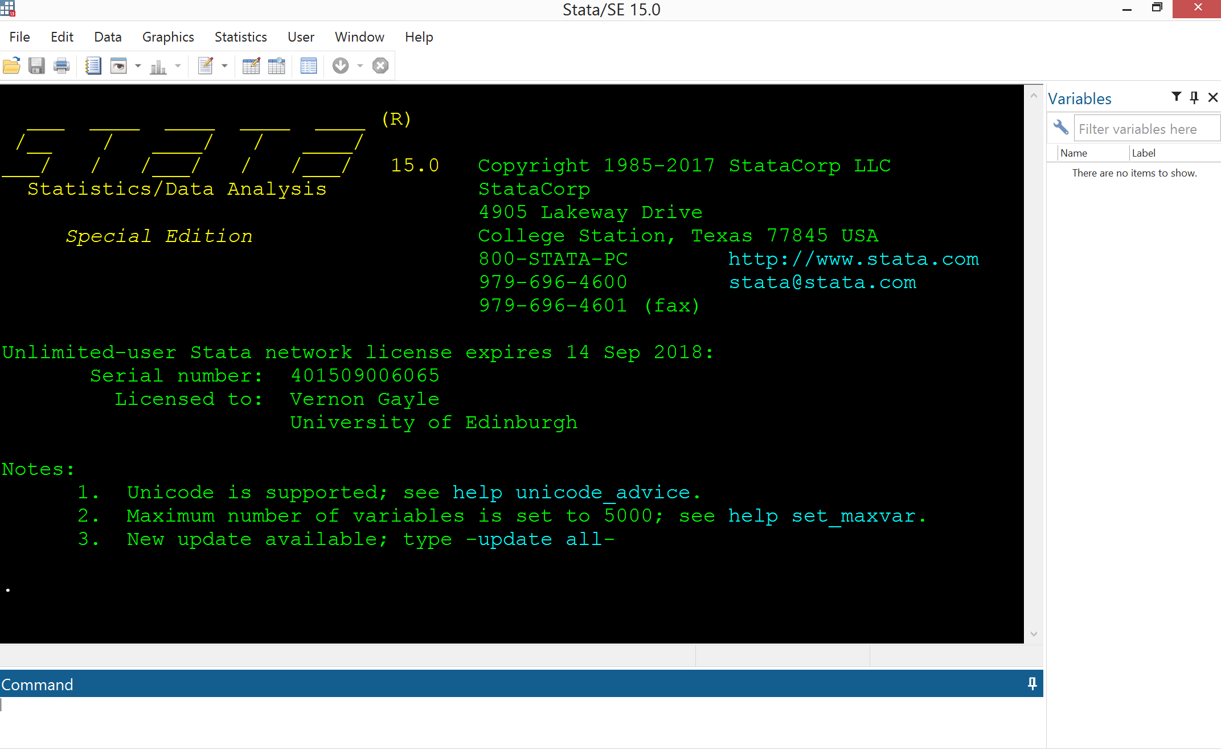

Slide 54
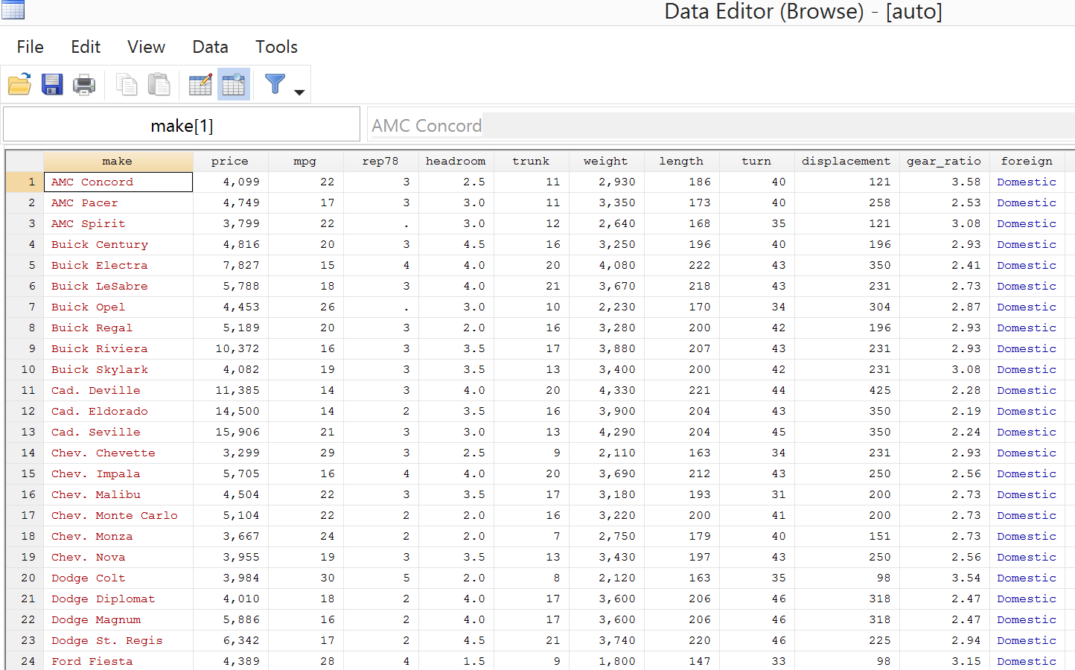
Data Editor (familiar spread sheet)

Slide 55
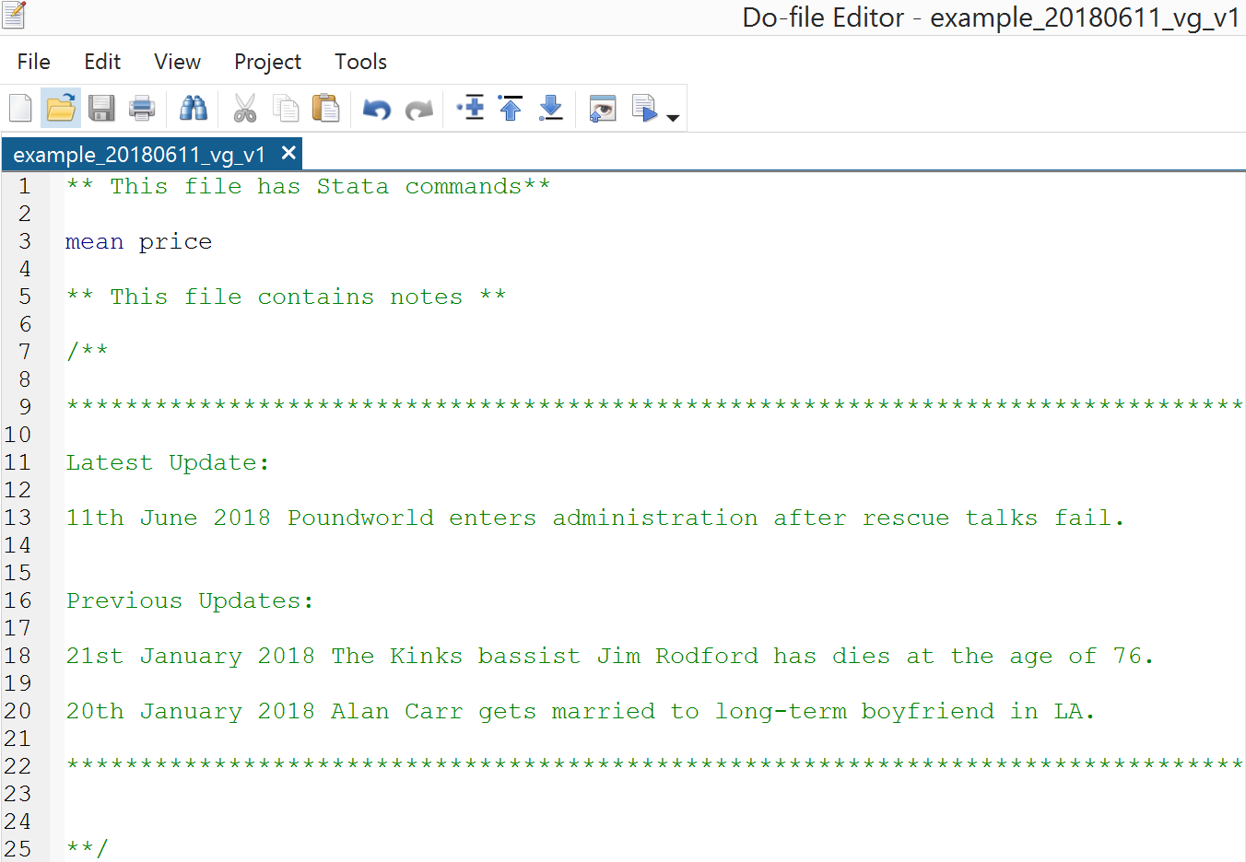
Syntax File .do

Slide 56
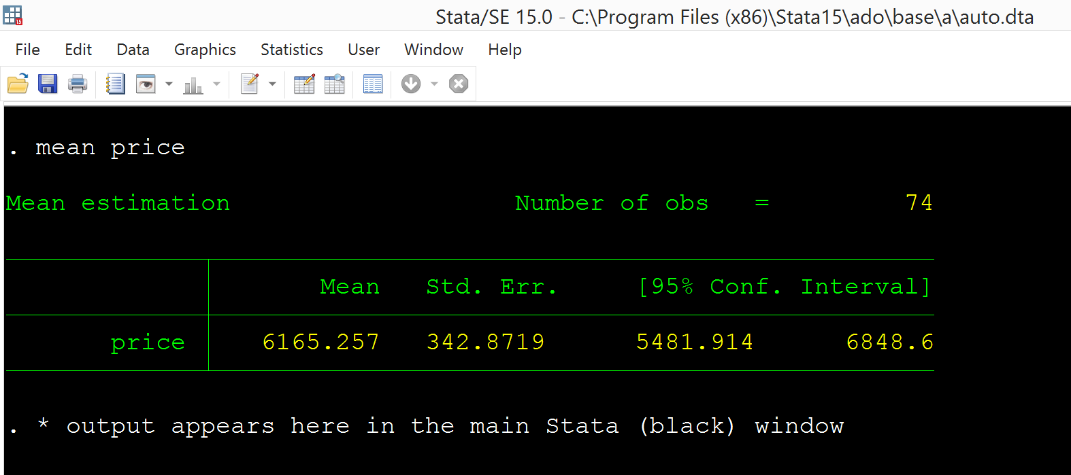
Stata Main Window (output)

Slide 58
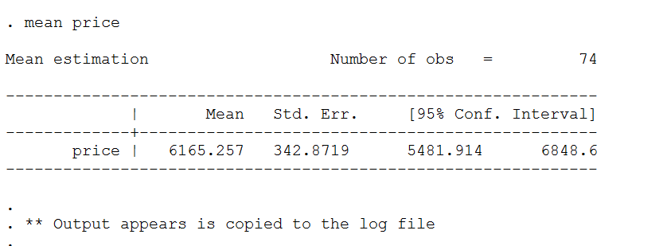
Log File (plain text)

Slide 60
Opening a .do file…

Slide 61
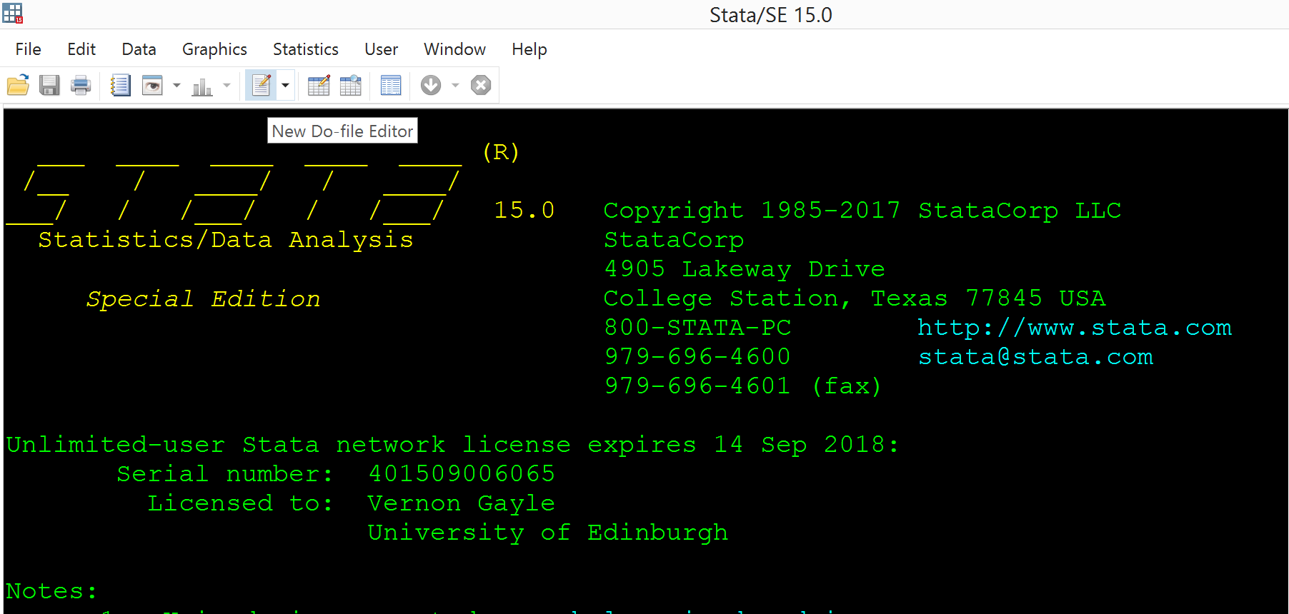

Slide 62
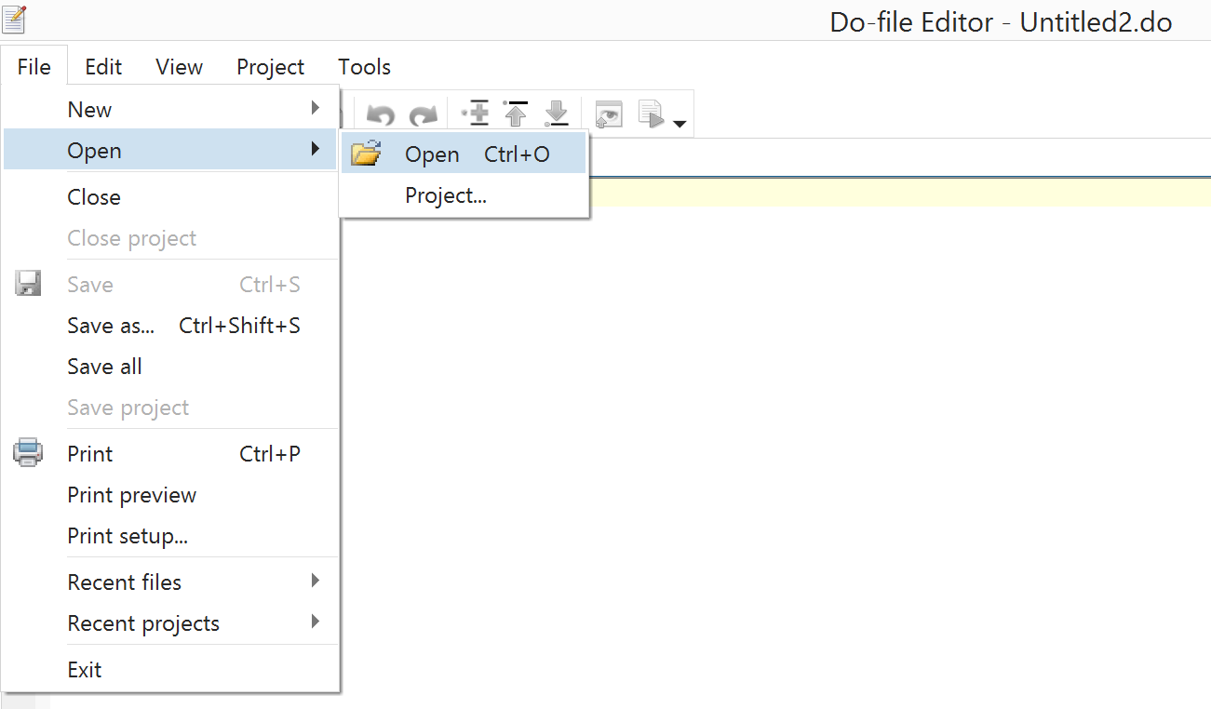

Slide 63
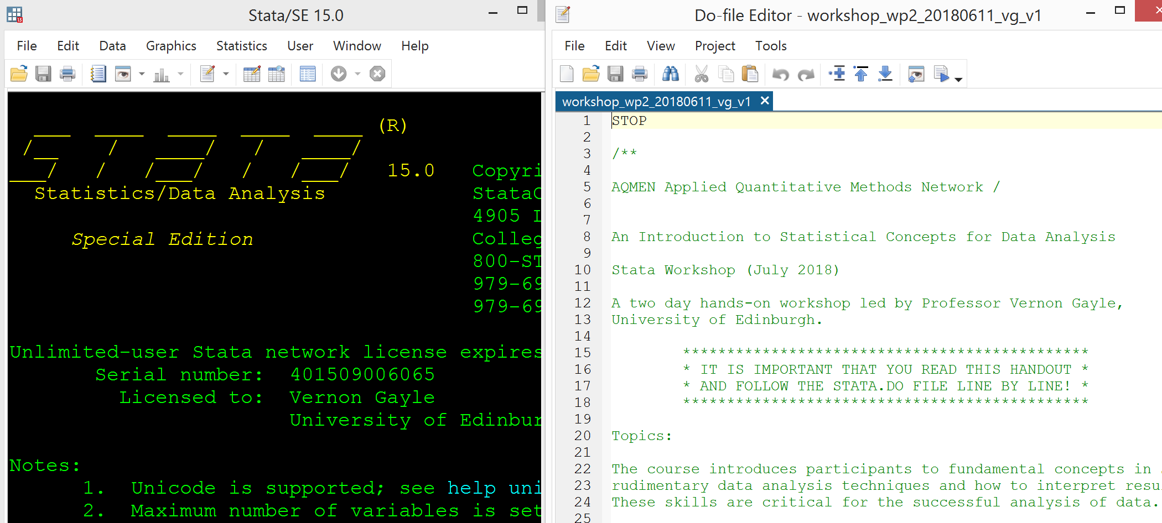

Slide 64
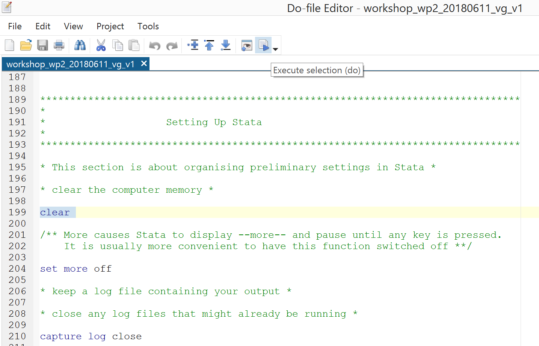

Slide 65
Techies might like to use ctrl d

Slide 66
Installing Packages
findit command can be used to search the Stata site and other sites for information
findit qvgraph
ssc install followed by the new programme’s name

Slide 67

Estimating Work Time…

Slide 68


Slide 69
GOOD LUCK!
Aim for GOLD and we might end up with BRONZE
Wednesday 25/07/2018 @ 16:45:
Proficient in enabling raw data for analysis in Stata
Knowledgeable in the core principles and practices of data wrangling
Awareness of open source tools that support reproducible analyses
Infused with a passion for data management…

Slide 70


Slide 71
Part III
Extensions

Slide 72
Open Source
Stata is a comprehensive and easy-to-learn statistical software package, however not suitable for every task/situation:
Proprietary
Likes variable-by-case data structures
Necessary but not sufficient for reproducible analyses

Slide 73
Open Source
Alternatives:
Gretl, R
JSON, XML best handled in Python
Jupyter Notebooks

Slide 74
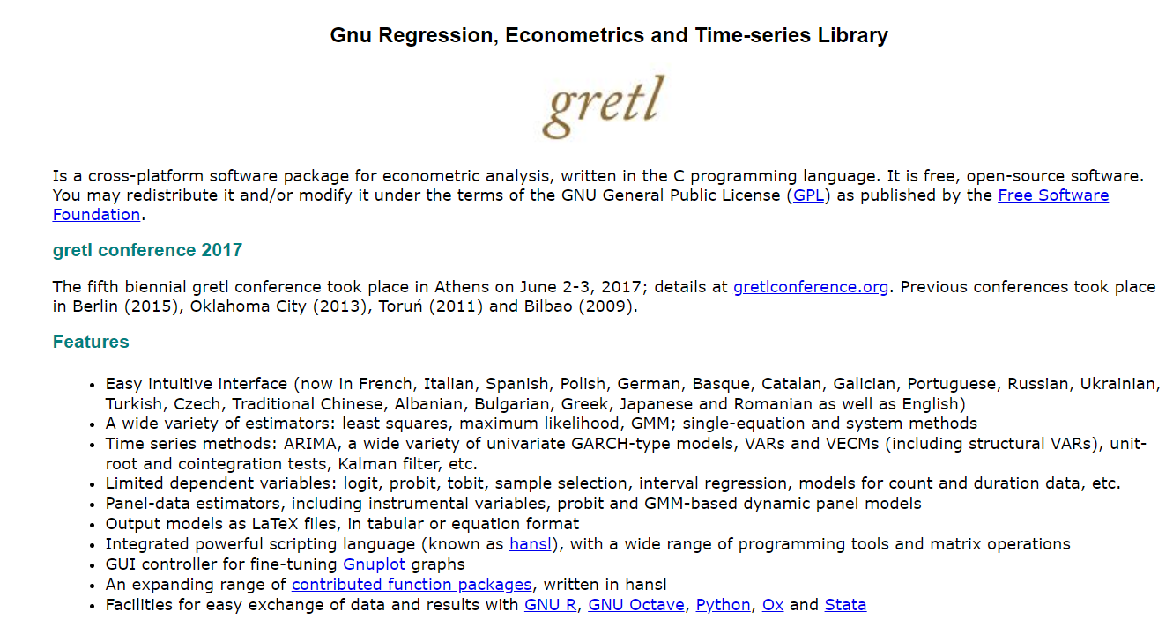
Gretl

Slide 75
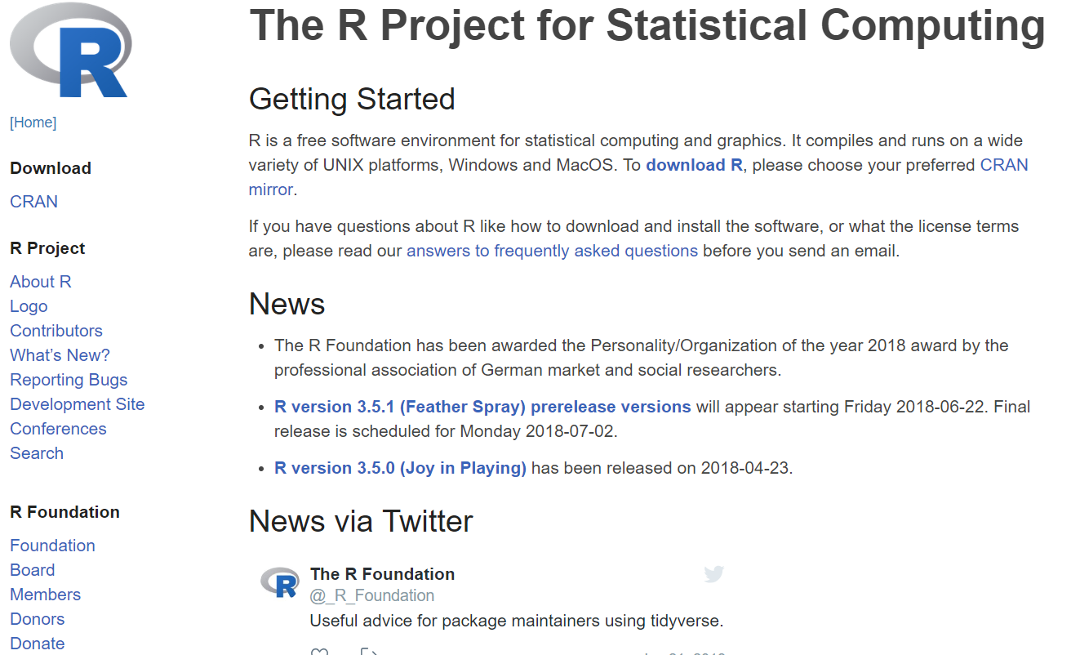
R

Slide 76
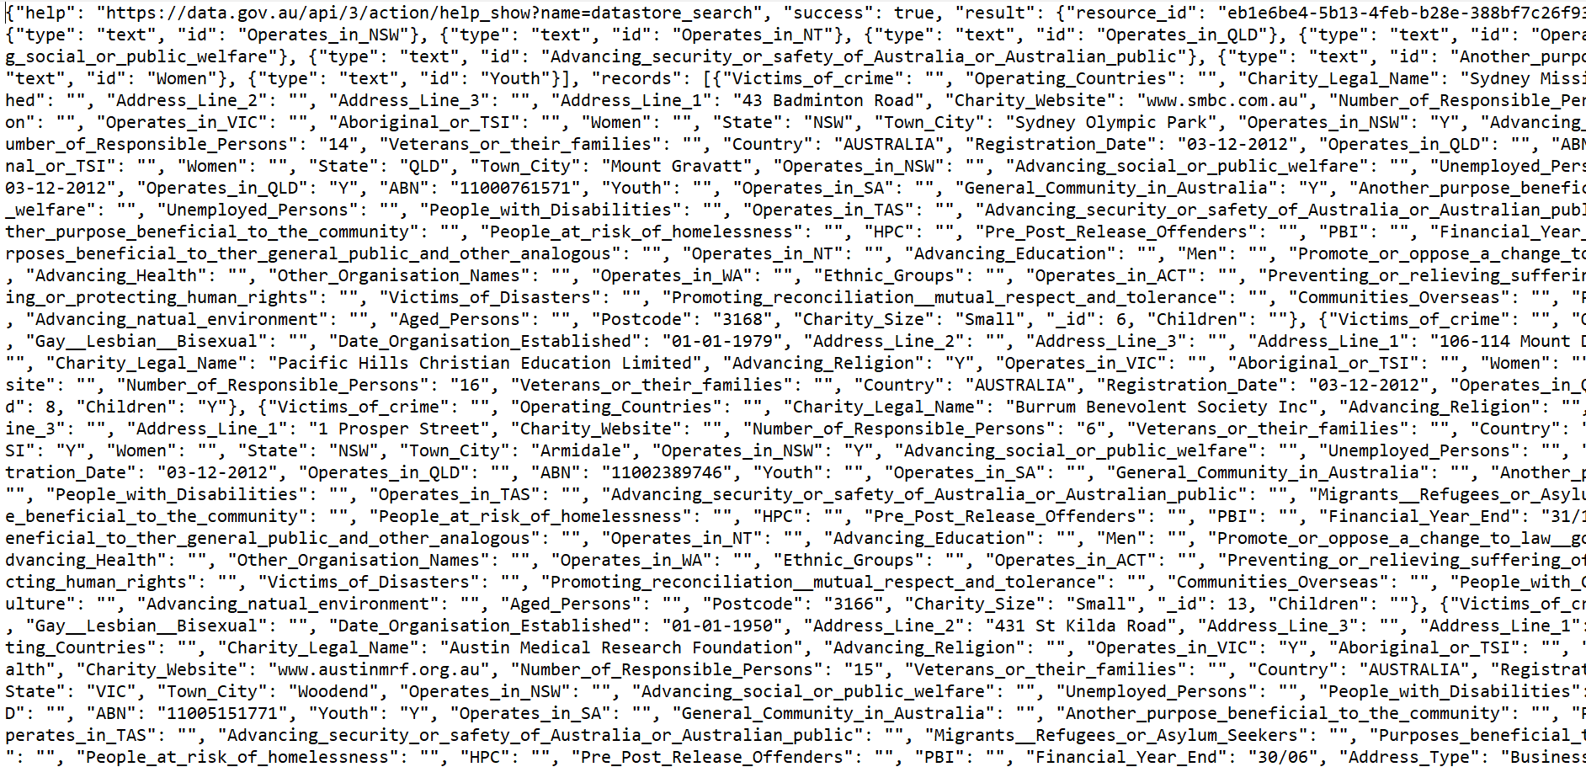
Alternative Data Structures
Notes:
Demonstrate Diarmuid’s web-scraping and API work.

Slide 77
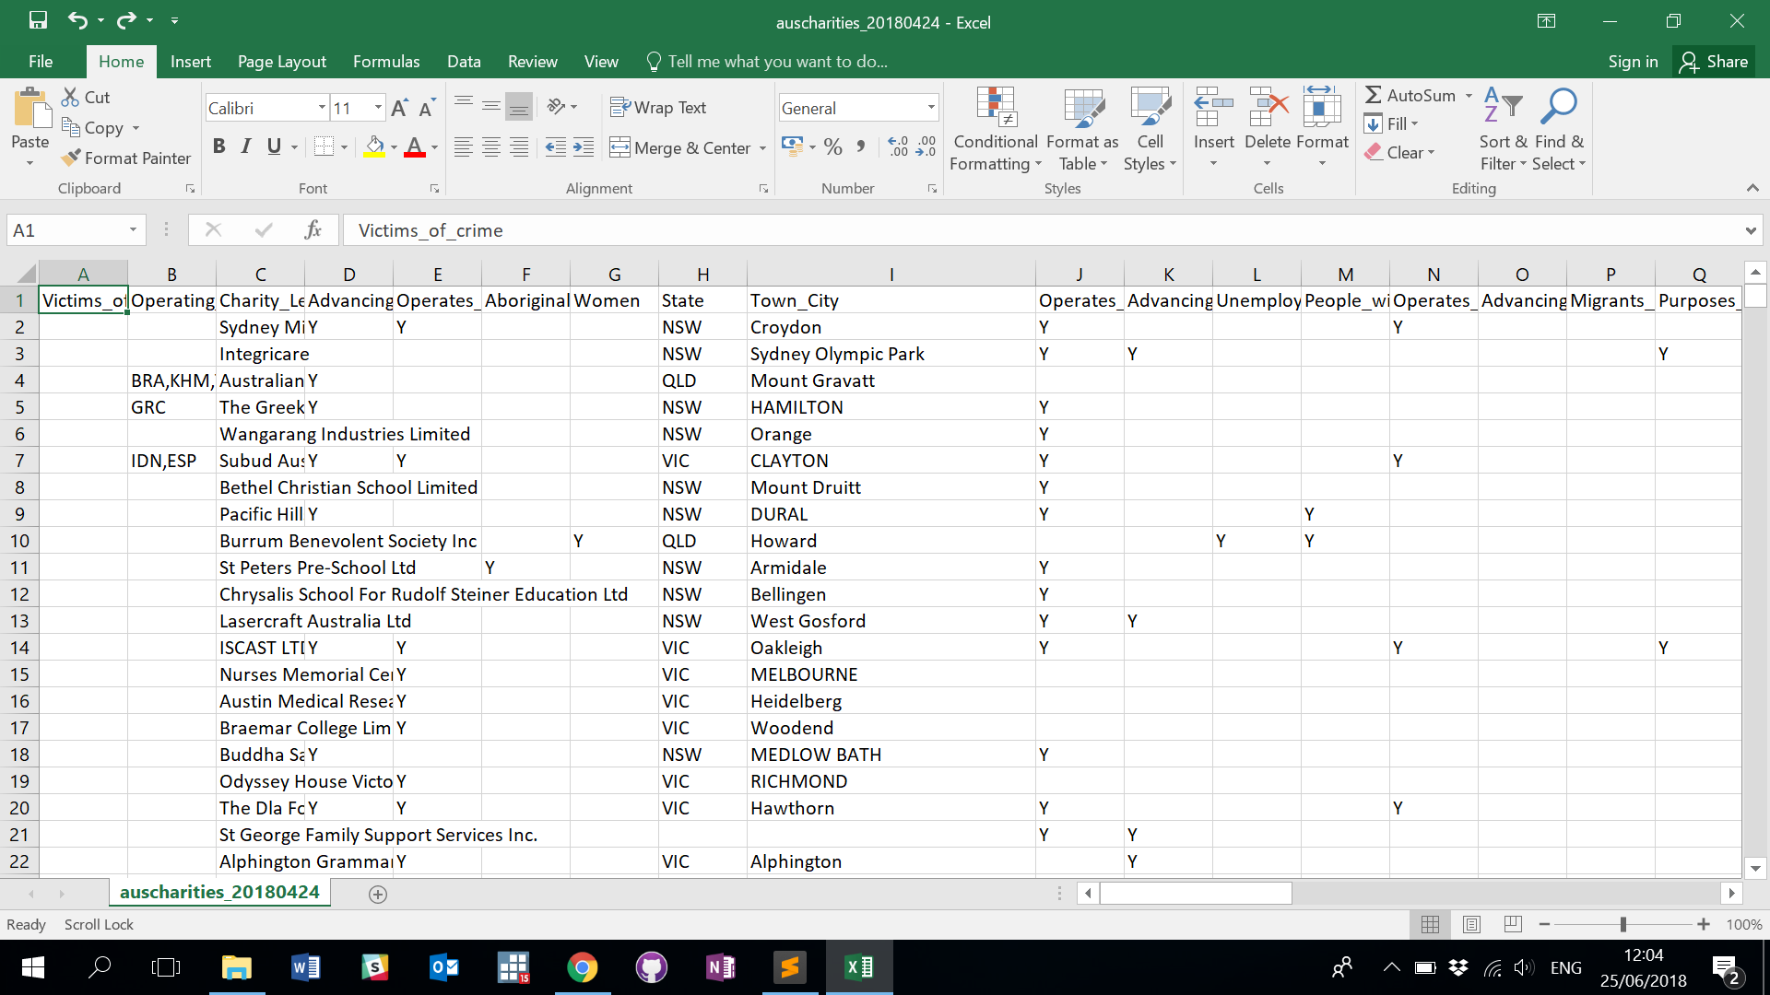
Voila
Notes:
Demonstrate Diarmuid’s web-scraping and API work.

Slide 78

Jupyter Notebooks

Slide 79
Plenary
Have at it:
Outstanding queries
Potential applications of Stata and data wrangling in your organisation
Unmet needs

Slide 80


Data Wrangling & Munging: Organising, Managing and Enabling Data for Analysis©
Prof. John MacInnes & Dr Diarmuid McDonnell
University of Edinburgh
July 2018
© Diarmuid McDonnell

